Slide 1
Introduction

Slide 2
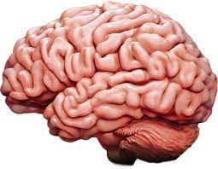
Building Intelligent Machines
The brain is the most incredible organ in the human body. It dictates the way we perceive every sight, sound, smell, taste, and touch.
It enables us to store memories, experience emotions, and even dream
The brain is, inherently, what makes us intelligent.

Slide 3
Building Intelligent Machines
The infant brain only weighs a single pound, but somehow it solves problems that even our biggest, most powerful supercomputers find impossible.
Within a matter of months after birth, infants can recognize the faces of their parents, discern discrete objects from their backgrounds, and even tell apart voices
Within a year, they’ve already developed an intuition for natural physics, can track objects even when they become partially or completely blocked, and can associate sounds with specific mean‐ ings. And by early childhood, they have a sophisticated understanding of grammar and thousands of words in their vocabularies

Slide 4
Building Intelligent Machines
we’ve dreamed of building intelligent machines with brains like ours— robotic assistants to clean our homes, cars that drive themselves, microscopes that automatically detect diseases.
But building these artificially intelligent machines requires us to solve some of the most complex computational problems we have ever grappled with; problems that our brains can already solve in a manner of microseconds.
To tackle these problems, we’ll have to develop a radically different way of programming a computer using techniques largely developed over the past decade. This is an extremely active field of artificial computer intelligence often referred to as deep learning.

Slide 5
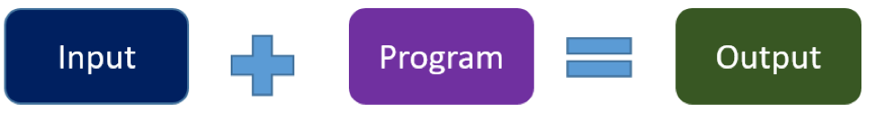
Traditional Programming
Traditional programming is a manual process—programmer creates the program. But without anyone programming the logic, one has to manually formulate or code rules.

Slide 6

Machine Learning Programming
Unlike traditional programming, machine learning is an automated process. It can increase the value of your embedded analytics in many areas, including data prep, natural language interfaces, automatic outlier detection, recommendations, and causality and significance detection. All of these features help speed user insights and reduce decision bias.

Slide 7
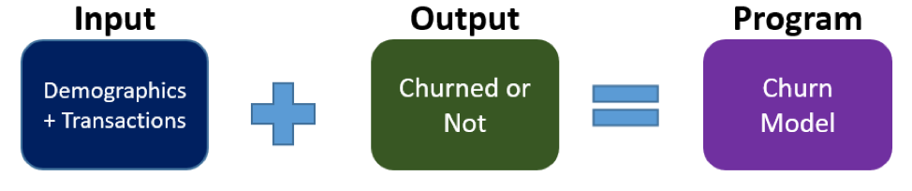
Machine Learning Programming
For example, if you feed in customer demographics and transactions as input data and use historical customer churn rates as your output data, the algorithm will formulate a program that can predict if a customer will churn or not. That program is called a predictive model.

Slide 8
Machine Learning Programming
You can use this model to predict business outcomes in any situation where you have input and historical output data:
Identify the business question you would like to ask.
Identify the historical input.
Identify the historically observed output (i.e., data samples for when the condition is true and for when it’s false).

Slide 9
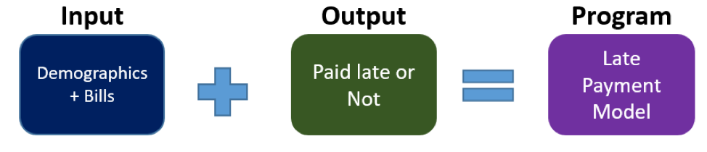
Machine Learning Programming
For instance, if you want to predict who will pay the bills late, identify the input (customer demographics, bills) and the output (pay late or not), and let the machine learning use this data to create your model.

Slide 10
Mechanics of Machine Learning
Deep learning is a subset of a more general field of artificial intelligence called machine learning, which is predicated on this idea of learning from example.
In machine learning, instead of teaching a computer a massive list of rules to solve the problem, we give it a model with which it can evaluate examples, and a small set of instructions to modify the model when it makes a mistake.
We expect that, over time, a well-suited model would be able to solve the problem extremely accurately

Slide 11
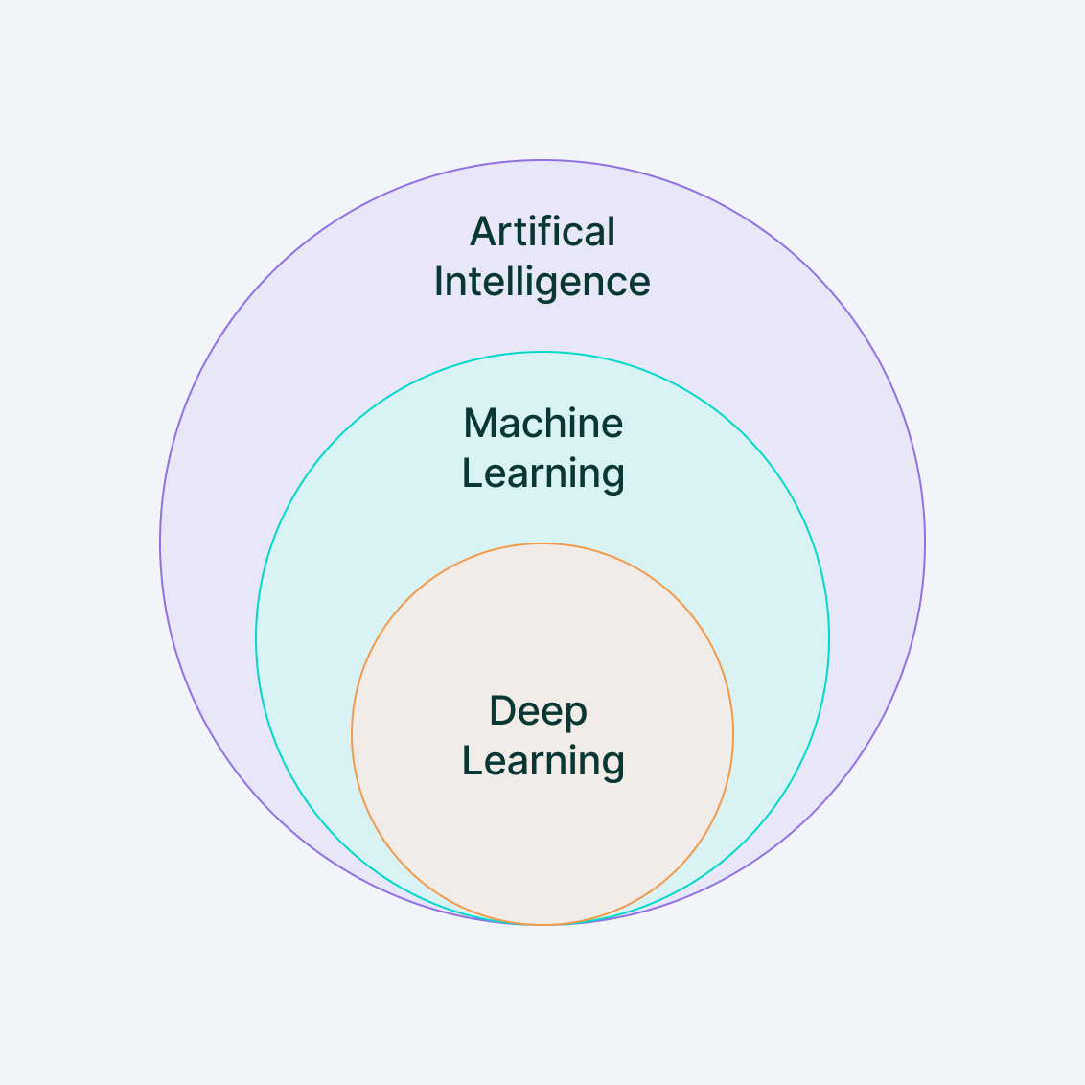
What is Deep Learning?
Deep Learning is a subset of Machine Learning that uses mathematical functions to map the input to the output. These functions can extract non-redundant information or patterns from the data, which enables them to form a relationship between the input and the output.
This is known as learning, and the process of learning is called training.

Slide 12
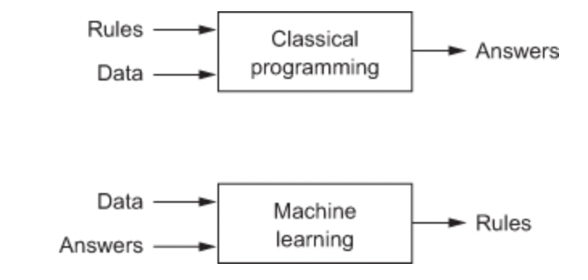
Deep learning VS Machine Learning
In traditional computer programming, input and a set of rules are combined together to get the desired output. In machine learning and deep learning, input and output are correlated to the rules.
These rules—when combined with new input—yield desired results.

Slide 13
Predict Exam performance
To determine how to predict exam performance based on the number of hours of sleep we get and the number of hours we study the previous day.
We collect a lot of data, and for each data point
we record the number of hours of sleep we got (x1), the number of hours we spent studying (x2), and whether we performed above or below the class average.
Our goal,then, might be to learn a model h(x,θ) with parameter vector

Slide 14
This model h (x, θ) is as described above (geometrically, this particular blueprint describes a linear classifier that divides the coordinate plane into two halves).
Then, we want to learn a parameter vector θ such that our model makes the right predictions (−1 if we perform below average, and 1 otherwise) given an input example x.
This model is called a linear perceptron,

Slide 16
Then it turns out, by selecting θ = −24 3 4 T, our machine learning model makes the correct prediction on every data point:
An optimal parameter vector θ positions the classifier so that we make as many correct predictions as possible. In most cases, there are many (or even infinitely many) possible choices for θ that are optimal
Solving this problem requires a technique commonly known as optimization. An optimizer aims to maximize the performance of a machine learning model by iteratively tweaking its parameters until the error is minimized.

Slide 18
Mechanics of Machine Learning
much more complex problems, such as object recognition and text analysis, our data becomes extremely high dimensional, and the relationships we want to capture become highly nonlinear.
To accommodate this complexity, recent research in machine learning has attempted to build models that resemble the structures utilized by our brains.
It’s essentially this body of research, commonly referred to as deep learning, that has had spectacular success in tackling problems in computer vision and natural language processing.

Slide 19
Biological Neuron
A human brain has billions of neurons. Neurons are interconnected nerve cells in the human brain that are involved in processing and transmitting chemical and electrical signals.
The neuron is optimized to receive information from other neurons, process this information in a unique way, and send its result to other cells.
The neuron receives its inputs along antennae-like structures called dendrites. Each of these incoming connections is dynamically strengthened or weakened based on how often it is used and it’s the strength of each connection that determines the contribution of the input to the neuron’s output
After being weighted by the strength of their respective connections,the inputs are summed together in the cell body. This sum is then transformed into a new signal that’s propagated along the cell’s axon and sent off to other neurons.

Slide 21
Biological Neuron
Cell nucleus or Soma processes the information received from dendrites.
Axon is a cable that is used by neurons to send information.
Synapse is the connection between an axon and other neuron dendrites.

Slide 22
Rise of Artificial Neurons
Researchers Warren McCullock and Walter Pitts published their first concept of simplified brain cell in 1943. This was called McCullock-Pitts (MCP) neuron. They described such a nerve cell as a simple logic gate with binary outputs.
Multiple signals arrive at the dendrites and are then integrated into the cell body, and, if the accumulated signal exceeds a certain threshold, an output signal is generated that will be passed on by the axon.

Slide 23
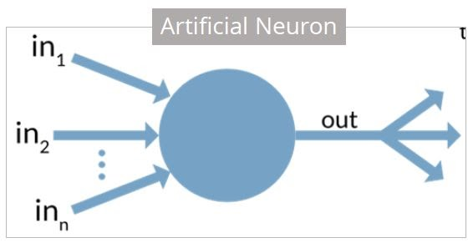
What is Artificial Neuron?
An artificial neuron is a mathematical function based on a model of biological neurons, where each neuron takes inputs, weighs them separately, sums them up and passes this sum through a nonlinear function to produce output.

Slide 24
Biological Neuron vs. Artificial Neuron
Biological Neuron | Artificial Neuron
Cell Nucleus (Soma) | Node
Dendrites | Input
Synapse | Weights or interconnections
Axon | Output

Slide 25
Artificial Neuron
The artificial neuron has the following characteristics:
A neuron is a mathematical function modeled on the working of biological neurons
It is an elementary unit in an artificial neural network
One or more inputs are separately weighted
Inputs are summed and passed through a nonlinear function to produce output
Every neuron holds an internal state called activation signal
Each connection link carries information about the input signal
Every neuron is connected to another neuron via connection link

Slide 26
Perceptron
Perceptron was introduced by Frank Rosenblatt in 1957. He proposed a Perceptron learning rule based on the original MCP neuron.
A Perceptron is an algorithm for supervised learning of binary classifiers.
This algorithm enables neurons to learn and processes elements in the training set one at a time.

Slide 27
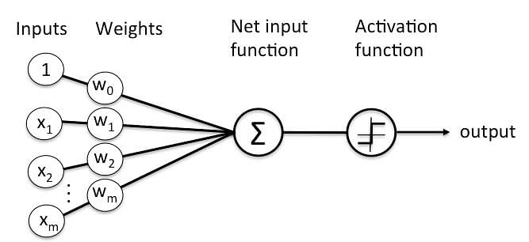

Slide 28
Types of Perceptrons
There are two types of Perceptrons: Single layer and Multilayer.
Single layer - Single layer perceptrons can learn only linearly separable patterns
Multilayer - Multilayer perceptrons or feedforward neural networks with two or more layers have the greater processing power
The Perceptron algorithm learns the weights for the input signals in order to draw a linear decision boundary.
This enables you to distinguish between the two linearly separable classes +1 and -1.

Slide 29
Perceptron Learning Rule
Perceptron Learning Rule states that the algorithm would automatically learn the optimal weight coefficients. The input features are then multiplied with these weights to determine if a neuron fires or not.
The Perceptron receives multiple input signals, and if the sum of the input signals exceeds a certain threshold, it either outputs a signal or does not return an output. In the context of supervised learning and classification, this can then be used to predict the class of a sample.

Slide 30
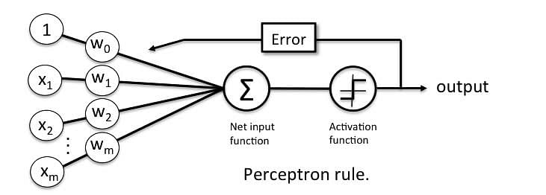

Slide 31

Perceptron Function
Perceptron is a function that maps its input “x,” which is multiplied with the learned weight coefficient; an output value ”f(x)”is generated.
In the equation given above:
“w” = vector of real-valued weights
“b” = bias (an element that adjusts the boundary away from origin without any dependence on the input value)
“x” = vector of input x values

Slide 32

Perceptron Function
“m” = number of inputs to the Perceptron
The output can be represented as “1” or “0.” It can also be represented as “1” or “-1” depending on which activation function is used.

Slide 33
Inputs of a Perceptron
A Perceptron accepts inputs, moderates them with certain weight values, then applies the transformation function to output the final result. The image below shows a Perceptron with a Boolean output.

Slide 34
Inputs of a Perceptron
A Boolean output is based on inputs such as salaried, married, age, past credit profile, etc. It has only two values: Yes and No or True and False. The summation function “∑” multiplies all inputs of “x” by weights “w” and then adds them up as follows:

Slide 35
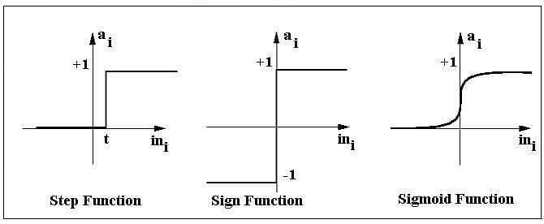
Activation Functions of Perceptron
The activation function applies a step rule (convert the numerical output into +1 or -1) to check if the output of the weighting function is greater than zero or not.

Slide 36
Activation Functions of Perceptron
For example:
If ∑ wixi> 0 => then final output “o” = 1 (issue bank loan)
Else, final output “o” = -1 (deny bank loan)
Step function gets triggered above a certain value of the neuron output; else it outputs zero.
Sign Function outputs +1 or -1 depending on whether neuron output is greater than zero or not.
Sigmoid is the S-curve and outputs a value between 0 and 1.

Slide 37

Output of Perceptron
Perceptron with a Boolean output:
Inputs: x1…xn
Output: o(x1….xn)
Weights: wi=> contribution of input xi to the Perceptron output;
w0=> bias or threshold
If ∑w.x > 0, output is +1, else -1. The neuron gets triggered only when weighted input reaches a certain threshold value.

Slide 38
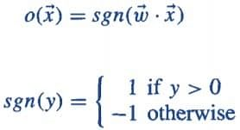
Output of Perceptron
An output of +1 specifies that the neuron is triggered.
An output of -1 specifies that the neuron did not get triggered.
“sgn” stands for sign function with output +1 or -1.

Slide 39
Error in Perceptron
In the Perceptron Learning Rule, the predicted output is compared with the known output. If it does not match, the error is propagated backward to allow weight adjustment to happen.

Slide 40
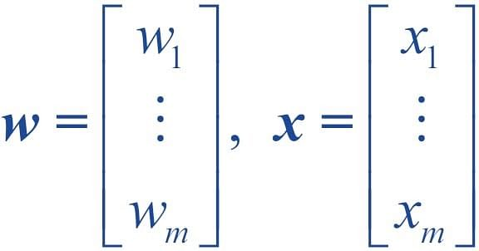
Perceptron: Decision Function
A decision function φ(z) of Perceptron is defined to take a linear combination of x and w vectors.
The value z in the decision function is given by:

Slide 41

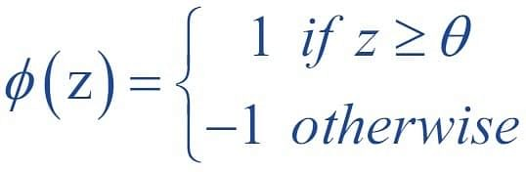
The value z in the decision function is given by:
The decision function is +1 if z is greater than a threshold θ, and it is -1 otherwise.
This is the Perceptron algorithm.

Slide 42
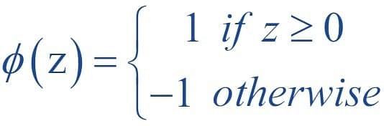
Bias Unit
For simplicity, the threshold θ can be brought to the left and represented as w0x0, where w0= -θ and x0= 1.
The value w0 is called the bias unit.
The decision function then becomes:

Slide 43
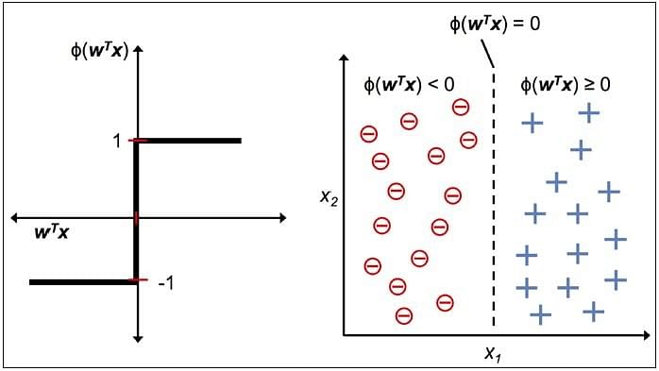
Output:
The figure shows how the decision function squashes wTx to either +1 or -1 and how it can be used to discriminate between two linearly separable classes.

Slide 44
Perceptron characteristics:
Perceptron is an algorithm for Supervised Learning of single layer binary linear classifiers.
Optimal weight coefficients are automatically learned.
Weights are multiplied with the input features and decision is made if the neuron is fired or not.
Activation function applies a step rule to check if the output of the weighting function is greater than zero.
Linear decision boundary is drawn enabling the distinction between the two linearly separable classes +1 and -1.
If the sum of the input signals exceeds a certain threshold, it outputs a signal; otherwise, there is no output.
Types of activation functions include the sign, step, and sigmoid functions.

Slide 45
Thank U

